Slide 1
James Hoffman
Predicting the Super Bowl
A machine-learning approach

Slide 2

CONTENT
➔
☑
Problem
Statement
Metrics &
Assumptions
Approach
& Process
The Model
Performance
Evaluation
Impact &
Next Steps
What problem we are trying to solve
The context of the technical approach
What technical approach was chosen
What the resulting model looks like
How well the
model performs
How the model can be used and improved

Slide 3
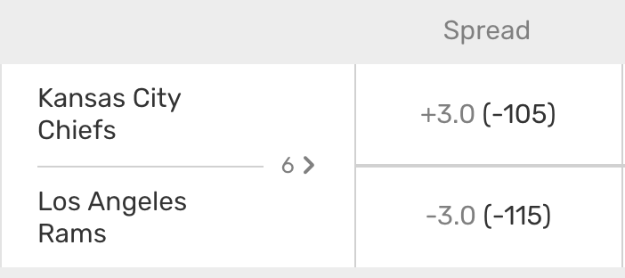
Problem Statement
Before most NFL football games, there is a team that is favored to win by a specific number of points given by the “spread”
Theoretically, there are even odds of the favored team “beating” the spread (i.e. winning by more than the spread)
Can the amount of points by which the favored team will “beat” the spread in a Super Bowl be predicted from past data?
Example spread for tonight’s Monday Night Football game

Slide 4

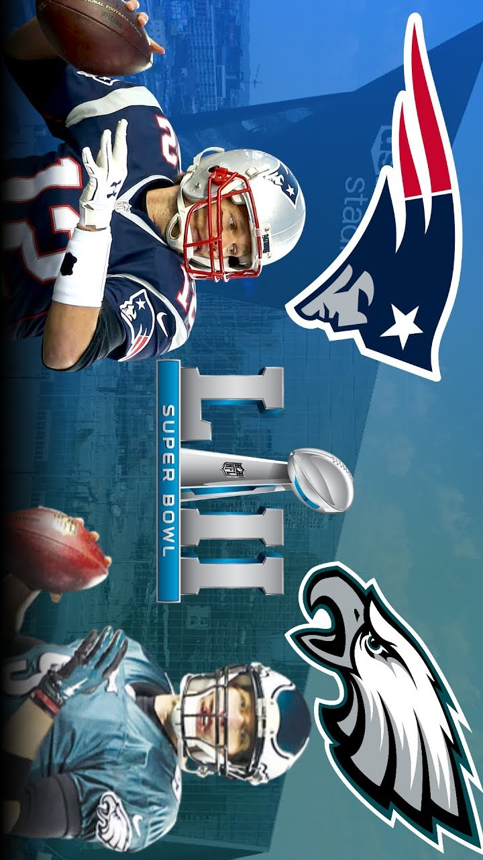
Metrics & Assumptions
Success Metrics
Use data from 1980 to 2016 to train a model, and correctly predict whether the Patriots beat the spread in Super Bowl LII (2017)
Achieve a lower model error measure than the null model
Assumptions
NFL rules and format are consistent enough across the 1980 to 2017 timeframe for the data to be relevant to one another
Injuries can be a major factor in any sports match but are not specifically included in this model

Slide 5
Approach & Process
This is an overview of the major steps that were performed to create and test the machine-learning algorithm to predict if the favored team will “beat” the spread in a Super Bowl
Cleaned Data and
Derived Additional
Features
Fitted and
Tested Model
Evaluated
Performance
Acquired Datasets
NFL Scores and Betting Data (Kaggle)
Pro-football-reference.com
Trained on all but one season at a time
Tested the remaining
season
Compared average accuracy to null model accuracy
Tested input feature
correlation
Limited data from 1980-2017
Derived 10 additional
features to test

Slide 6
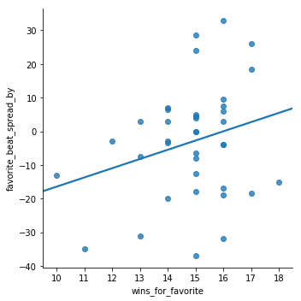
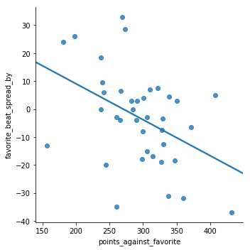
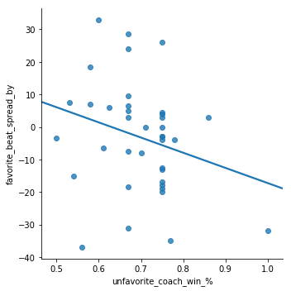
The Model: Choosing Features
These are the 3 features that were useful in improving the accuracy of our model, plotted against the target variable. From this we can extrapolate that the favored team's good record beats spread, the favored team's lack of defense loses to the spread, and the unfavored team’s winning coach beats the spread
How many points the favored team beat the spread by
Number of wins by favored team during season
Points scored against favored team during season
Career playoff win % of coach of unfavored team going into Super Bowl

Slide 7
The Model
Features
Model constructed using linear regression on data from 1980 to 2016
Model for predicting 2017 Super Bowl spread result
y = 31.58 + 2.88 * (Number of wins by favored team during season)
- 0.15 * (Points scored against favored team during season)
- 48.19 * (Career playoff win % of coach of unfavored team going into Super Bowl)
2017 Inputs and Predicted Result
Test Data
Number of wins by favored team during season = 15
Points scored against favored team during season = 330
Career playoff win % of coach of unfavored team going into superbowl = 0.75
Prediction
How many points the favored team beat the spread by ~ -10.5
Actual Result
How many points the favored team beat the spread by = -12
Model Fitting
Fitted Model
Test Data
Prediction

Slide 8
Performance Evaluation
The performance of a null model which always predicts the average value as the outcome is a useful benchmark. On average, our model performs better than the null model. As usual, the test data doesn’t perform as well as the training data that was used to create the model.
17.1
13.5
15.3
Null Model
Error Measure
Model Error Measure on Training Data
Model Error Measure on Test Data
Accuracy of model that predicts the average result
Accuracy of our model applied to training data
Accuracy of our model applied to test data

Slide 9
Impact & Next Steps
Our model performed better than the null model so the input features chosen do have some predictive power
This model should not be used in solitude to make predictions because it still contains substantial error, but could be used to reinforce predictions made based on other factors
Testing additional input features would likely lead to a more accurate model

Slide 10
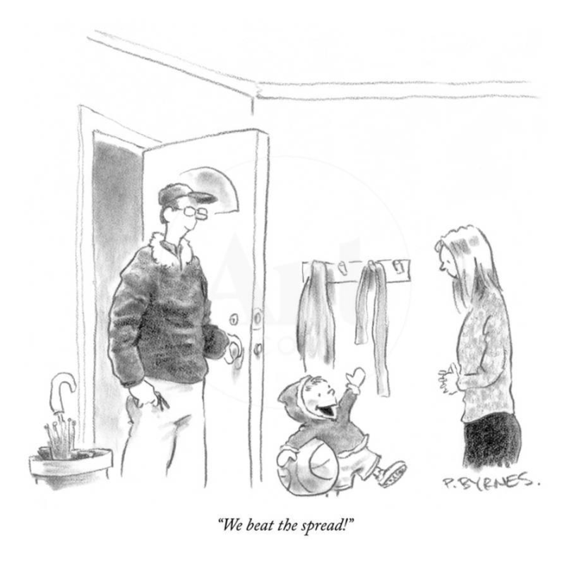
Questions?

Slide 11
Back Up

Slide 12
ANALYSIS
Refers to a good or service being offered by a company. Ideally, a product should meet a certain consumer demand, or it should be so compelling that consumers believe.
Title One
Refers to a good or service being offered by a company. a product
20%
50%
Title Two
Refers to a good or service being offered by a company. a product
30%
Title Three
Refers to a good or service being offered by a company. a product

Slide 13
Title One
Title Two
Title Three
Title Four
To be successful, marketers should understand the life cycle of a product.
To be successful, marketers should understand the life cycle of a product.
To be successful, marketers should understand the life cycle of a product.
To be successful, marketers should understand the life cycle of a product.

